Slide 1
Cache Memory

Slide 2
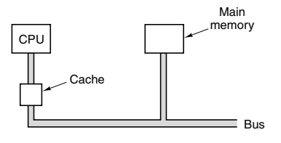
Cache Memory
CPU registers are limited in number (cost, CPU chip size are key factors)
More small, fast memory called cache memory is used (cacher: to hide in French, and pronounced ‘cash’)
The most heavily used memory words are copied in the cache – CPU first checks cache, if data is not in cache, it goes to main memory

Slide 3


Principle of Locality
A program accesses a relatively small portion of address space at any given time
Two types of principle of locality
Temporal locality (Locality in time): If some data is referenced, it will be referenced again soon
Spatial locality (Locality in space): If some data is referenced, data near it will also be referenced

Slide 4
Hit Ratio, Miss Ratio
Hit Ratio (%) = (Number of Cache Hits / Total Memory Accesses) × 100%
Miss Ratio = 100% - Hit Ratio
Example: Suppose you have a cache system in a web server that receives 1,000 requests for web pages, and the cache is able to serve 800 of those requests from the cache (cache hits), while the remaining 200 requests had to be fetched from the main server (cache misses)
Hit Ratio = (800/1000) x 100 = 80%
Miss Ratio = 100% - 80% = 20%

Slide 5
Cache Line
Cache line: Divide main memory and cache into fixed-size blocks
Cache miss -> Entire cache is loaded into main memory, not just the needed word? Why? Principle of locality
Example: Suppose cache line size is 64 bytes
CPU wants data at memory address 260
Result: Entire line consisting of bytes 256 to 319 will be loaded into a cache line
Reason: The CPU will most likely need words around this address soon (Principle of locality)
Memory Blocks
Block 1: Bytes 0-63
Block 2: Bytes 63-127
Block 3: Bytes 128-191
Block 4: Bytes 192-255
Block 5: Bytes 256-319
Cache
Block 5: Bytes 256-319

Slide 6
Direct-mapped Cache
Remember, cache line = 32 or 64 or 128 bytes at a time
But generally, the CPU needs one/two bytes from this at a time, not the whole 32/64/128 bytes
Direct-mapped cache: Identify the exact word/byte in a cache line?
How? Map One memory location -> One cache location using cache index + offset
Example: Suppose our program now wants to read from memory location 1010000001100100
A memory address is divided into three parts:
Tag: Real address in the main memory
Index: For the above address, cache line containing 32 bits
Offset: Specific byte within a cache line

Slide 7
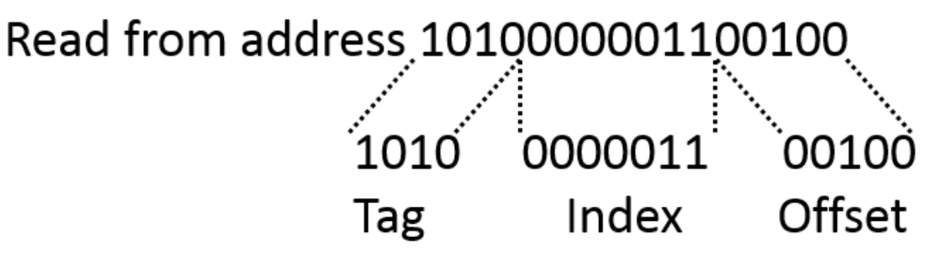
Direct-Mapped Cache
Example: Suppose our program now wants to read from memory location 1010000001100100 and cache is blank
This index binary value 0000011 i.e. 3 in decimal is used to lookup the cache

Slide 8
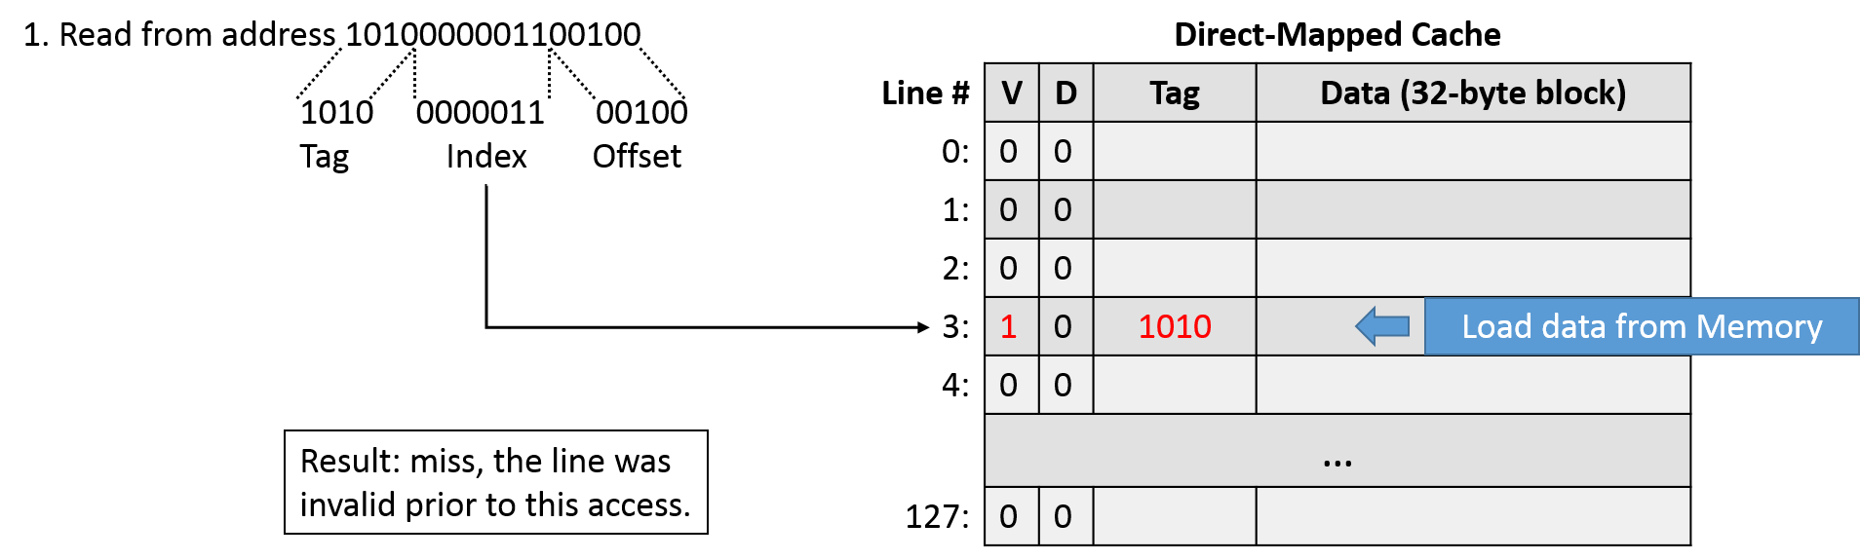
Direct-Mapped Cache
V = Valid?
D = Dirty?
Since the cache line was empty, this was a cache miss. We need to go to main memory location 1010, get the 32-byte block from there, write in the cache at index 00000011, update the valid flag to 1 and return the 32-bit block to the program. Next time whenever anyone wants to read the 32-byte block at memory location 1010, we will have a cache hit.

Slide 9
Cache Optimizing Techniques
Cache size optimization: Increase cache size (but cost will increase)
Cache replacement policies: Least Recently Used (LRU), Most Recently Used (MRU), Random
Cache associativity: Mapping of cache lines to cache sets (Discussed separately)
Prefetching: Cache anticipates and fetches data before it is actually demanded
Write policies: Write-back (Write only in cache and update main memory only when necessary) or Write-through (Write to cache and to main memory)
Data locality: Repeated access to same instructions/data
Multi-level cache: L1 (Fastest) to L3 (Slowest) … Still, L3 will be faster than main memory

Slide 10
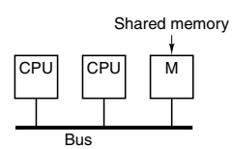
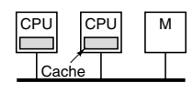
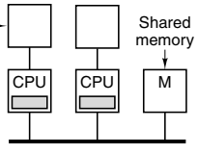
UMA (Unified Memory Access) Symmetric Multiprocessor Architecture
Multiprocessor = Multicore = Multiple CPUs in one computer
Simplest architecture: Single bus
All CPUs and memory modules use the same bus
If number of CPUs is very high, it will be a bottleneck
Solution: Add a cache to each CPU
Need to use memory will reduce
Another approach: Each CPU will have its cache and also private memory and some shared memory

Slide 11
Snooping Cache
Cache coherence/Cache inconsistency
CPU 1 has a cache line (Data read from main memory into its cache)
CPU 2 also has the same cache line next
CPU 1 modifies the line
Now CPU 2 has stale data
Solution: Cache snooping
Options: Write-through, MESI

Slide 12
Write-through Cache Coherence Protocol
Action | Local request | Remote request
Read miss | Fetch data from memory
Read hit | Use data from local cache
Write miss | Update data in memory and do not load this data from memory till update is complete
Write hit | Update cache and memory | Invalidate cache entry
Four cases
Example
CPU 1 does a write
Cache 1 will make a write request on the bus
Does cache 2 has the data which is now being updated in Cache 1 (i.e. Do CPU 1 and CPU 2 both have the same data in their cache?)
If not (Remote Write miss), cache 2 does nothing
If yes (Remote Write hit), it marks its cache entry as invalid, otherwise it will have stale data

Slide 13
MESI
Each cache entry can be in one of the four states
Invalid: Cache entry does not contain valid data
Shared: Multiple caches may hold the line, data is up to date
Exclusive: No other cache holds the line, data is up to date
Modified: The entry is valid, memory is invalid, no copies exist
Initial boot: All CPUs mark their cache entries as invalid (Next slide)
Suppose CPU 1 reads line A – Exclusive (a)
CPU 2 also reads it – Shared (b)
CPU 2 writes – Sends invalidate signal on the bus so that all other CPUs discard their copies – The cached copy now becomes Modified (c)
CPU 3 wants a copy – CPU 2 asks it to wait, and when it finishes, CPU 3 fetches a copy – Shared (d)

Slide 14
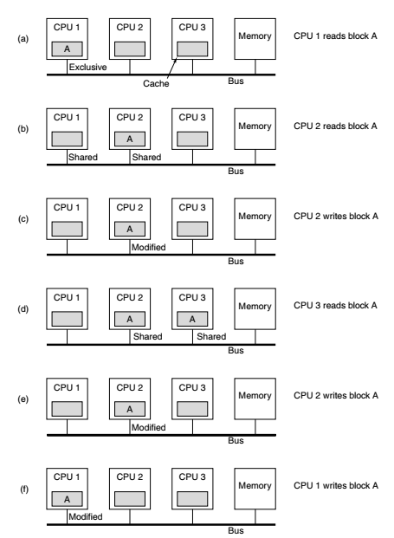
MESI

Slide 15
Using a Finite-State Machine to Control a Simple Cache
Using a Finite State Machine (FSM) to control a simple cache involves designing a set of states and transitions that manage cache operations
A cache FSM typically handles read and write operations, cache coherence, cache line replacement, and other control tasks
Defines states, inputs (events) and outputs (actions) using transition logic
States: Idle, Read, Write, Cache miss, Cache coherence
Inputs: External commands that change the state – Read, Write, Cache miss signal, Cache coherence signal
Outputs: Read requests to main memory, Updating of cache lines, Notifying the CPU of cache hits/misses, etc
Transition logic: Conditions under which state transitions can occur (Example: When a Read request is received, state might change from idle to read)

Slide 16
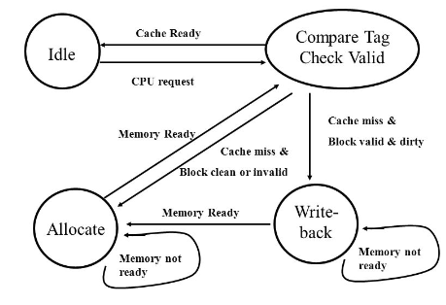
Sample FSM for Cache Operations

